Slide 1
Chemistry 3A
Introductory General Chemistry
Avogadro’s Number, The Mole, Conversions of Atoms & Moles, Molar Mass, Mass & Particle Number, Percent Composition, Empirical Formula, % Water in a Hydrate, Molecular Formula
S. M. Halloran

Slide 2
The Mole: Avogadro’s Number
Moles and Atoms: Conversions
Molar Mass
Moles and Mass: Conversions
Mass and Particle Number
Percent Composition
Empirical Formulas
Percent of Water in a Hydrate
Molecular Formulas

Slide 3
Avogadro’s Number
Counting atoms and molecules and submicroscopic particles one-by-one is impossible task
Italian scientist Amadeo Avogadro devised the mole
Avogadro’s Number is the number of representative particles of a substance equal to 6.022 × 10²³
SI unit for amount of a substance
The official symbol for Avogadro’s Number is N_{A}

Slide 4
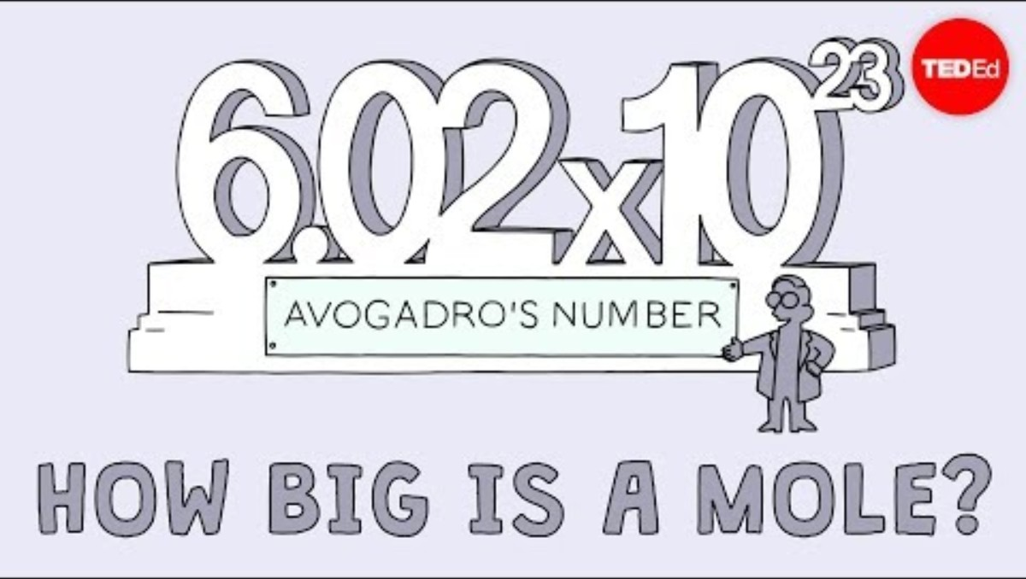
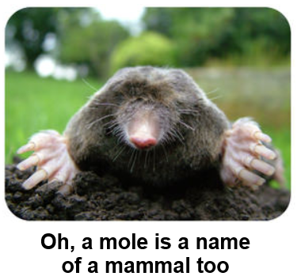
Avogadro’s Number
The number is of a count of particles making up 1 mole (1 mol)
Your online book
includes YouTube
link on mole
concept
Substance | Representative Particle
Most elements, particularly metals | Atom
Diatomic elements: (H₂, O₂, N₂, F₂, Cl₂, Br₂, I₂) Many molecular compounds: H₂O, CO₂ | Molecule
Ionic Compounds: NaCl, Ca(NO₃)₂ | Formula Unit

Slide 5

Monotony Break Student Wake-Up Call
DIY Pest Control or Commercial?
Termites
Ants, Wasps/Hornets
Inside and Outside the House
Costs
Talstar P
  general chemical for
  outside house
  pyrethroids
  mimic pyrethrins from chrysanthemums

Slide 6
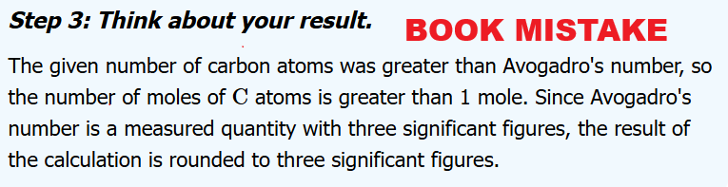
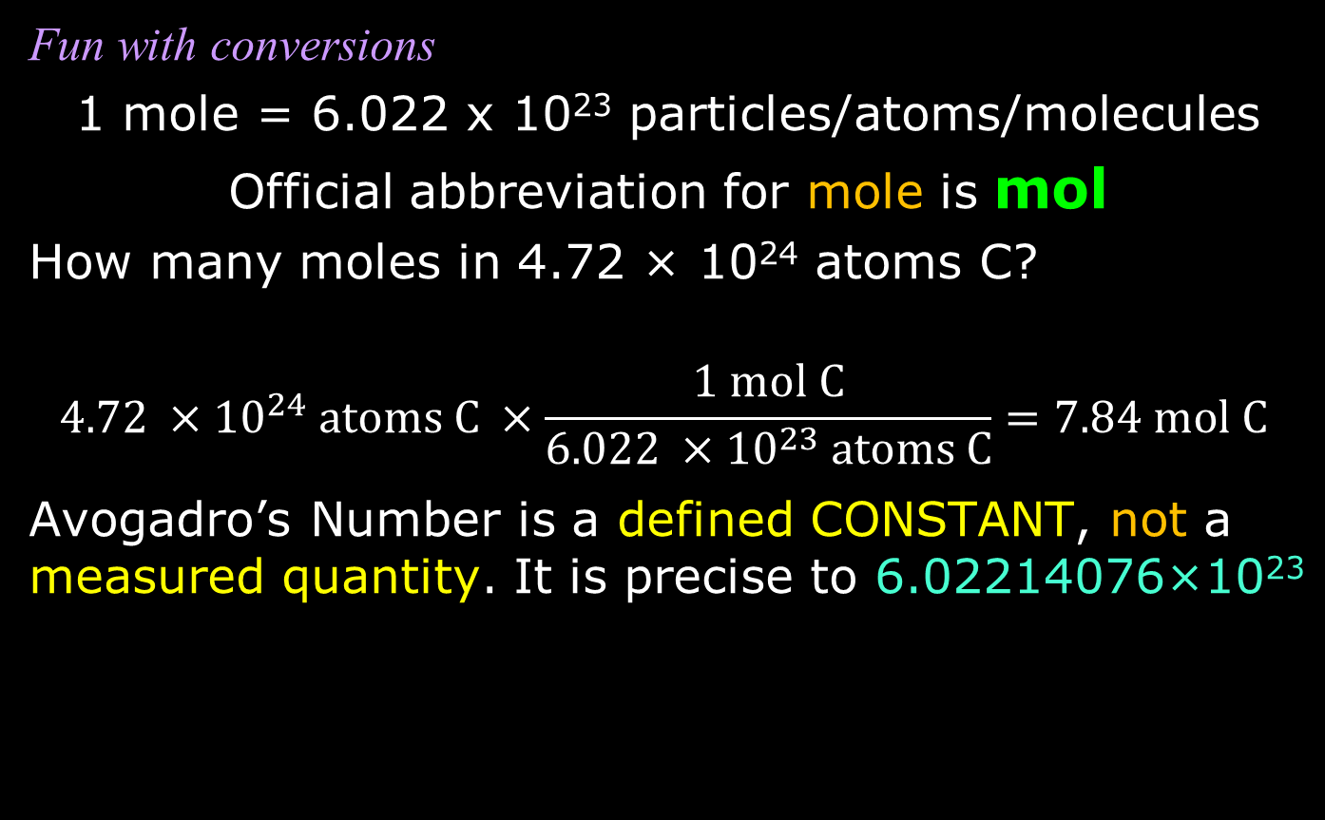
Moles to/from Atoms/Molecules/Particles
Fun with conversions
1 mole = 6.022 x 10²³ particles/atoms/molecules
Official abbreviation for mole is mol
How many moles in 4.72 × 10²⁴ atoms C?
$$4.72 ×{10}^{24} \text{atoms C} ×\frac{1 \text{mol C}}{6.022 ×{10}^{23} \text{atoms C}}=7.84 \text{mol C}$$
Avogadro’s Number is a defined CONSTANT, not a measured quantity. It is precise to 6.02214076×10²³

Slide 7
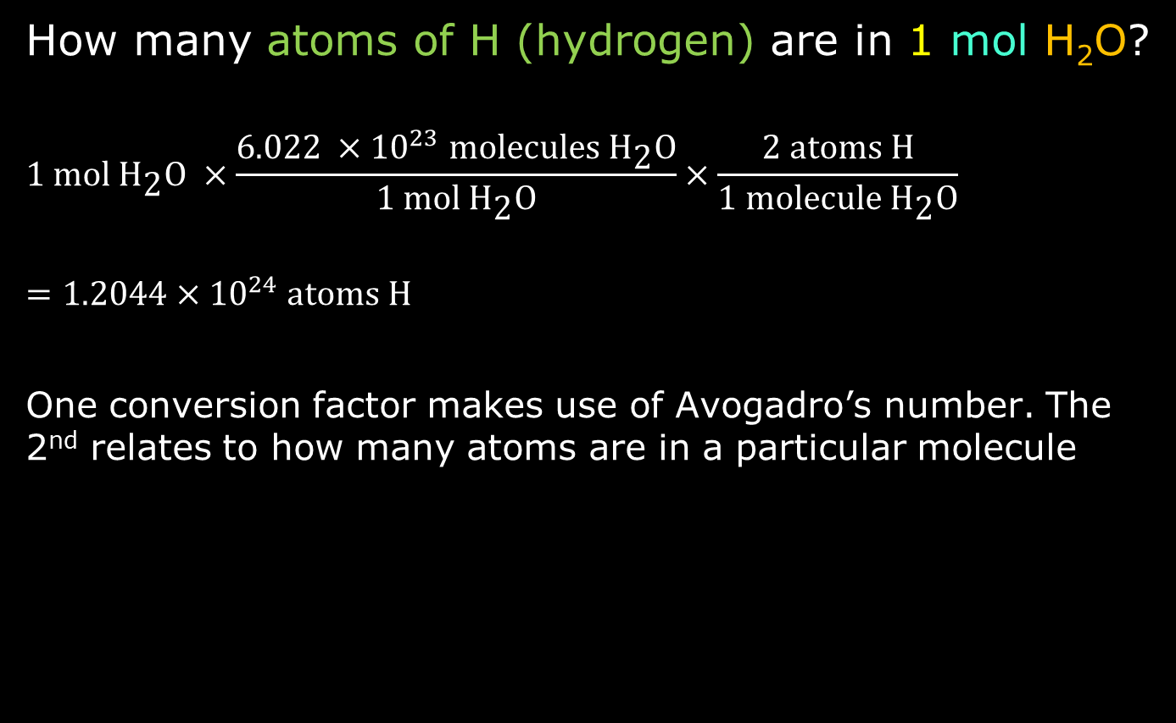
Moles to/from Atoms/Molecules/Particles
How many atoms of H (hydrogen) are in 1 mol H₂O?
$$1 \text{mol }{\text{H}}_{\text{2}}\text{O} ×\frac{6.022 ×{10}^{23} \text{molecules}{\text{ H}}_{\text{2}}\text{O}}{1 \text{mol }{\text{H}}_{\text{2}}\text{O}}×\frac{2 \text{atoms H}}{\text{1 }\text{molecule}{\text{ H}}_{\text{2}}\text{O}}$$
$$=1.2044×{10}^{24} \text{atoms} \text{H}$$
One conversion factor makes use of Avogadro’s number. The 2nd relates to how many atoms are in a particular molecule

Slide 8
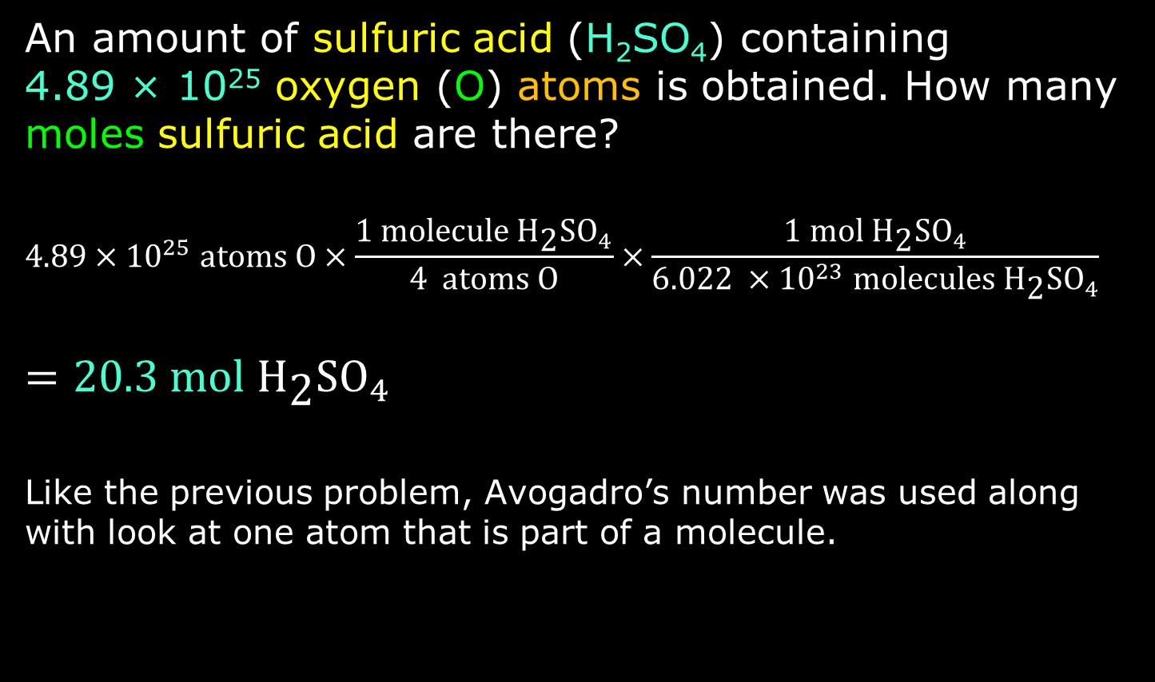
Another Conversion Example
An amount of sulfuric acid (H₂SO₄) containing
4.89 × 10²⁵ oxygen (O) atoms is obtained. How many moles sulfuric acid are there?
$$4.89×{10}^{25}\text{ atoms O}×\frac{1 \text{molecule}{\text{ H}}_{\text{2}}{\text{SO}}_{4}}{4 \text{atoms O}}×\frac{1 \text{mol}{\text{ H}}_{\text{2}}{\text{SO}}_{4}}{6.022 ×{10}^{23} \text{molecule}\text{s}{\text{ H}}_{\text{2}}{\text{SO}}_{4}}$$
$$=20.3 \text{mol}{\text{ H}}_{\text{2}}{\text{SO}}_{4}$$
Like the previous problem, Avogadro’s number was used along with look at one atom that is part of a molecule.

Slide 9
Particle Mass: Atomic Mass,
Molecular Mass, Formula Mass
Atoms, molecules, and formula units represent particles
They all have varying masses, which depends on the particle identity
At atomic/molecular/formula unit level as
single particles, these masses should be in units of atomic mass units (amu)
But at very large particle counts, namely Avogadro Numbers of particles (the mole), the masses are best thought of in terms of
molar mass, whose units are in
grams per mole (g/mol)

Slide 10
Molar Mass
The term molar mass refers to the mass
(in grams) of one mole of a substance.
The units are (usually) grams per mole
  Whenever the term mass is used, it will refer to a quantity whose units will be in grams (or a power of 10 in grams: kilograms [kg], milligrams [mg], micrograms [µg], etc). A molar mass will be grams per mole.
The substance can be atoms (pure element), molecules, or particles
Note the old terms atomic weight (for pure elements and molecular weight for molecules and compounds are deprecated

Slide 11
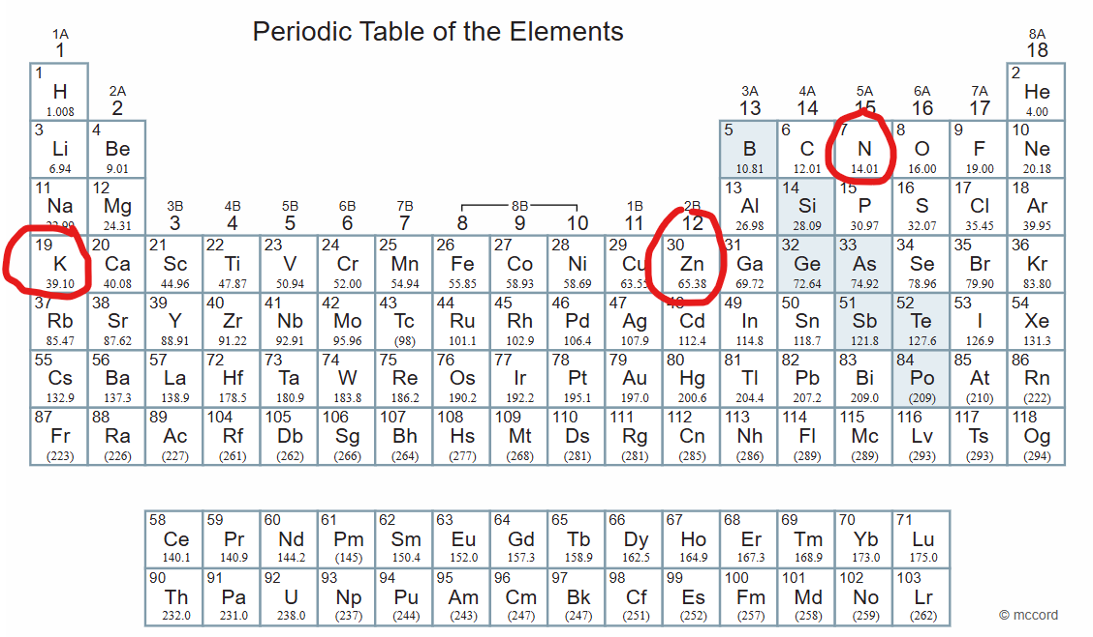
Determining Molar Mass
For atoms of the pure elements, the molar mass is on the Periodic Table
Nitrogen (N): 14.01 grams per mole (g/mol)
Zinc (Zn): 65.38 g/mol
Potassium (K): 39.10 g/mol

Slide 12
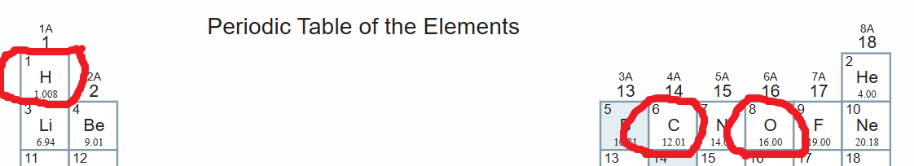
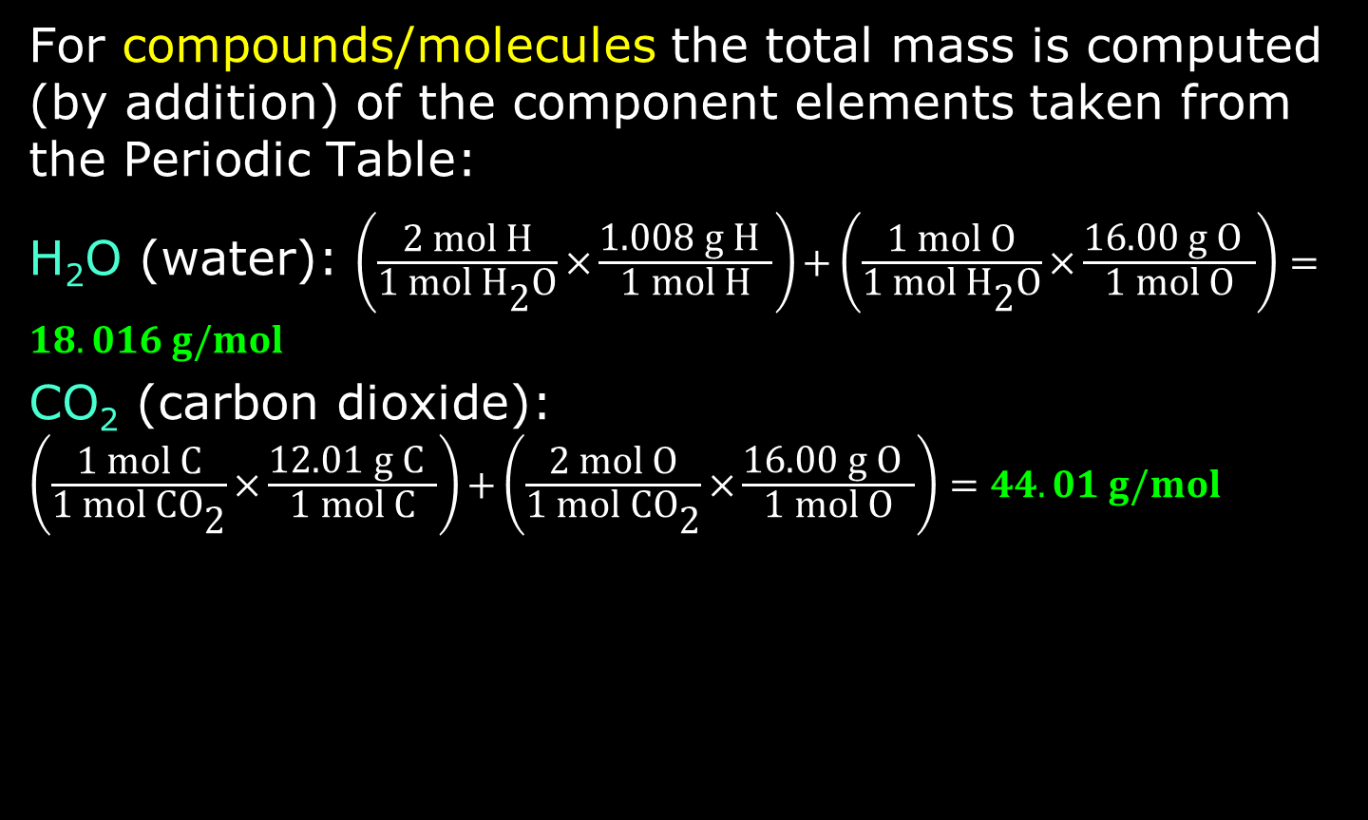
Determining Molar Mass
For compounds/molecules the total mass is computed (by addition) of the component elements taken from the Periodic Table:
H₂O (water): $\left(\frac{\text{2 mol H}}{\text{1 mol }{\text{H}}_{\text{2}}\text{O}}\text{×}\frac{\text{1.008 g H} }{\text{1 mol H}}\right)\text{+}\left(\frac{\text{1}\text{ mol O}}{\text{1 mol }{\text{H}}_{\text{2}}\text{O}}\text{×}\frac{\text{16.00 g O} }{\text{1 mol O}}\right)=18.016 g/mol$
CO₂ (carbon dioxide): $\left(\frac{\text{1}\text{ mol }\text{C}}{\text{1 mol }{\text{CO}}_{\text{2}}}\text{×}\frac{\text{12.01}\text{ g }\text{C} }{\text{1 mol }\text{C}}\right)\text{+}\left(\frac{\text{2}\text{ mol O}}{\text{1 mol }{\text{CO}}_{\text{2}}}\text{×}\frac{\text{16.00 g O} }{\text{1 mol O}}\right)=44.01 g/mol$

Slide 13
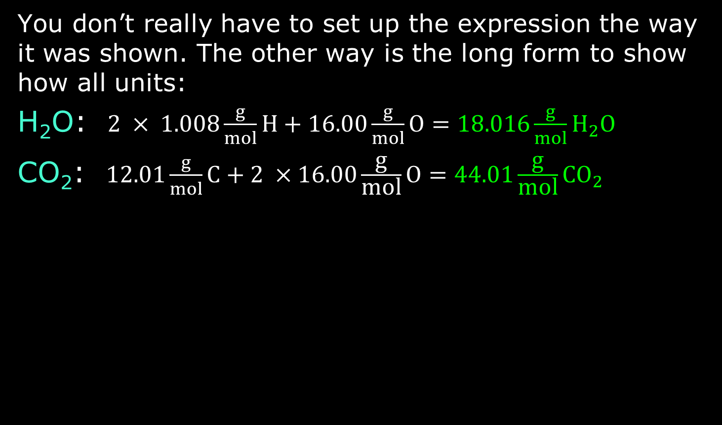
Computing Molar Mass
You don’t really have to set up the expression the way it was shown. The other way is the long form to show how all units:
H₂O: $2 × 1.008\frac{g}{mol}H+16.00\frac{g}{mol}O=18.016\frac{g}{mol}{\text{H}}_{2}\text{O}$
CO₂: $12.01\frac{g}{mol}C+2 ×16.00\frac{\text{g}}{\text{mol}}\text{O}=44.01\frac{\text{g}}{\text{mol}}{\text{CO}}_{2}$

Slide 14
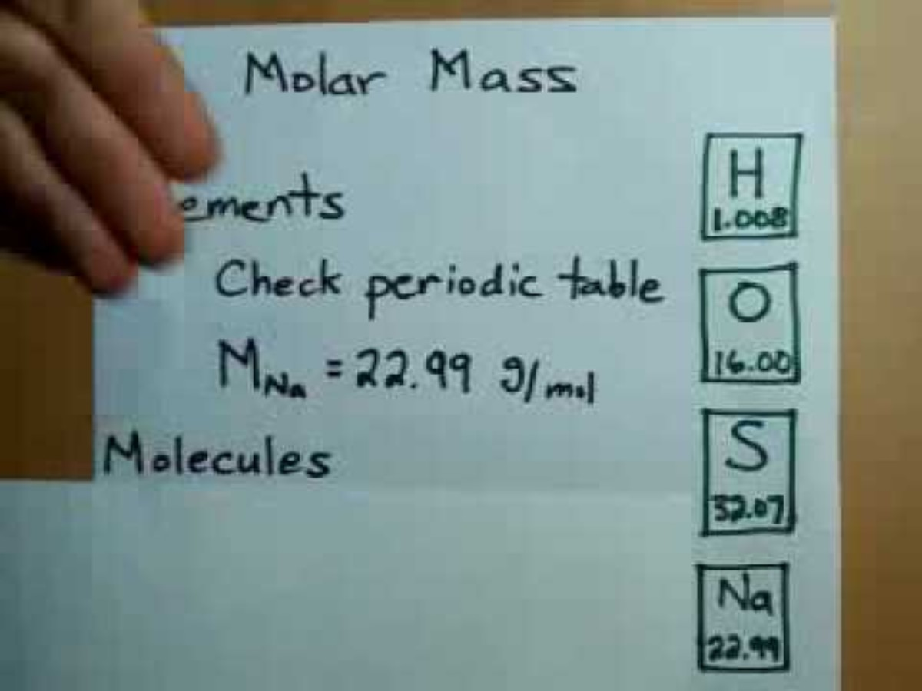
3 Minute Watch

Slide 15
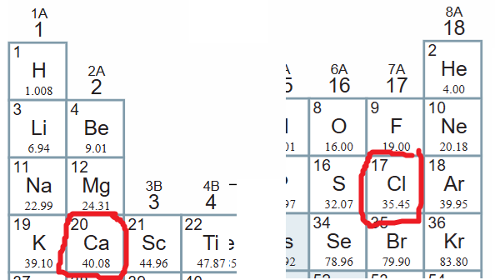
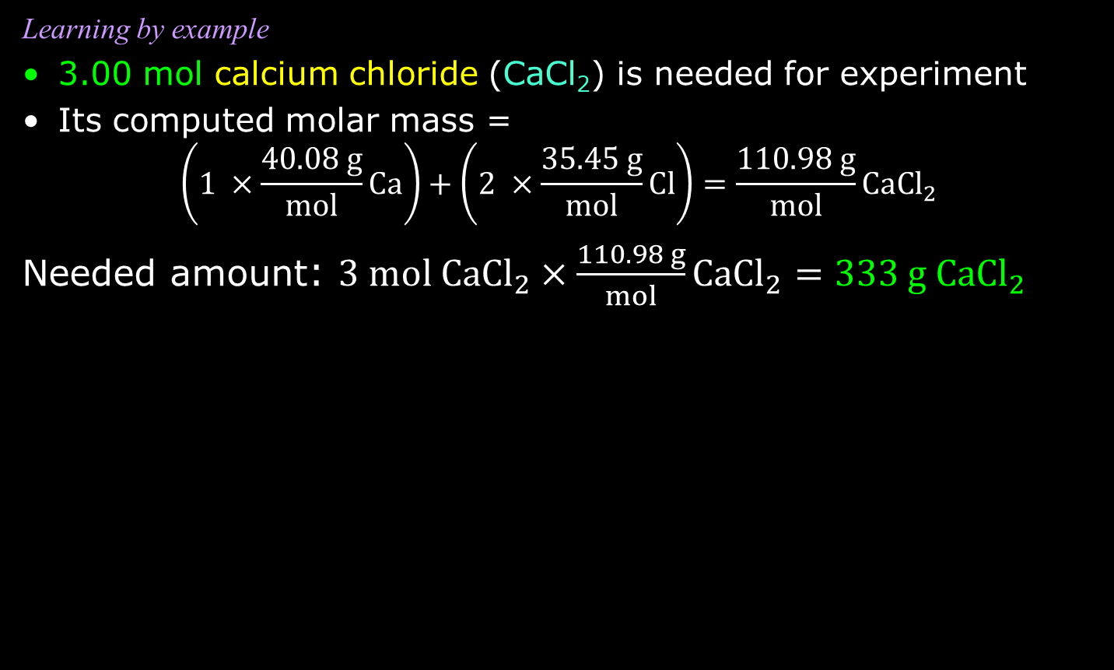
Moles ↔ Mass
Learning by example
3.00 mol calcium chloride (CaCl₂) is needed for experiment
Its computed molar mass =
$$\left(1 ×\frac{40.08 g}{mol}Ca\right)+\left(2 ×\frac{35.45 g}{mol}Cl\right)=\frac{110.98 g}{mol}{\text{CaCl}}_{2}$$
Needed amount: $3 mol{ \text{CaCl}}_{2}×\frac{110.98 g}{mol}{\text{CaCl}}_{2}=333 \text{g}{ \text{CaCl}}_{2}$

Slide 16
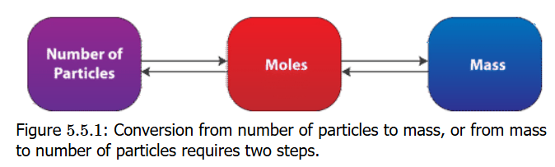
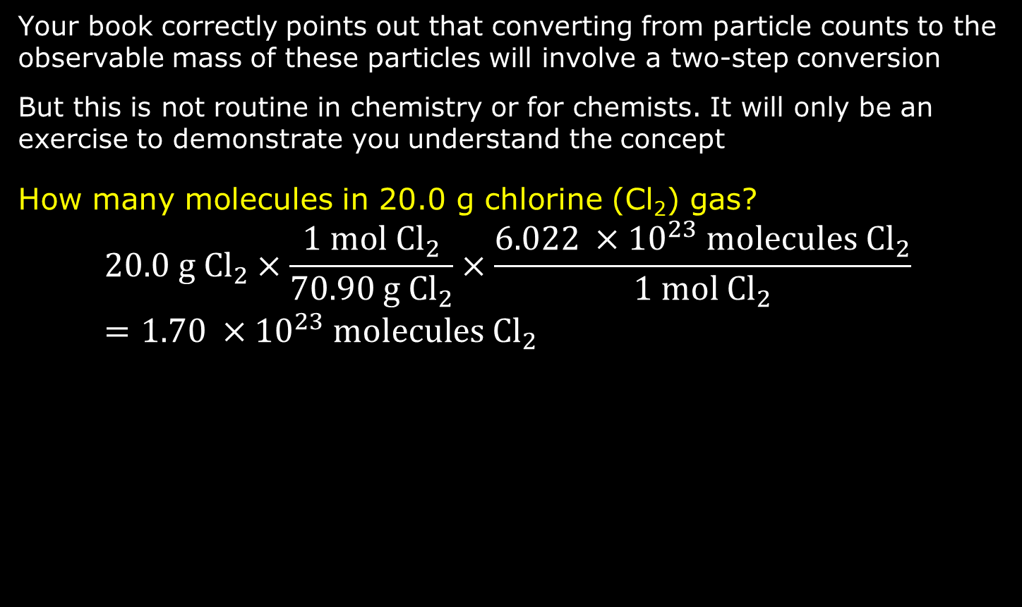
Moles ↔ Mass
Your book correctly points out that converting from particle counts to the observable mass of these particles will involve a two-step conversion
But this is not routine in chemistry or for chemists. It will only be an exercise to demonstrate you understand the concept
How many molecules in 20.0 g chlorine (Cl₂) gas?
$$20.0 g {\text{Cl}}_{2}×\frac{\text{1 mol} {\text{Cl}}_{2}}{\text{70.90 g} {\text{Cl}}_{2}}×\frac{6.022 ×{10}^{23}\text{ molecules} {\text{Cl}}_{2}}{1 mol {\text{Cl}}_{2}}=1.70 ×{10}^{23} \text{molecules} {\text{Cl}}_{2}$$

Slide 17
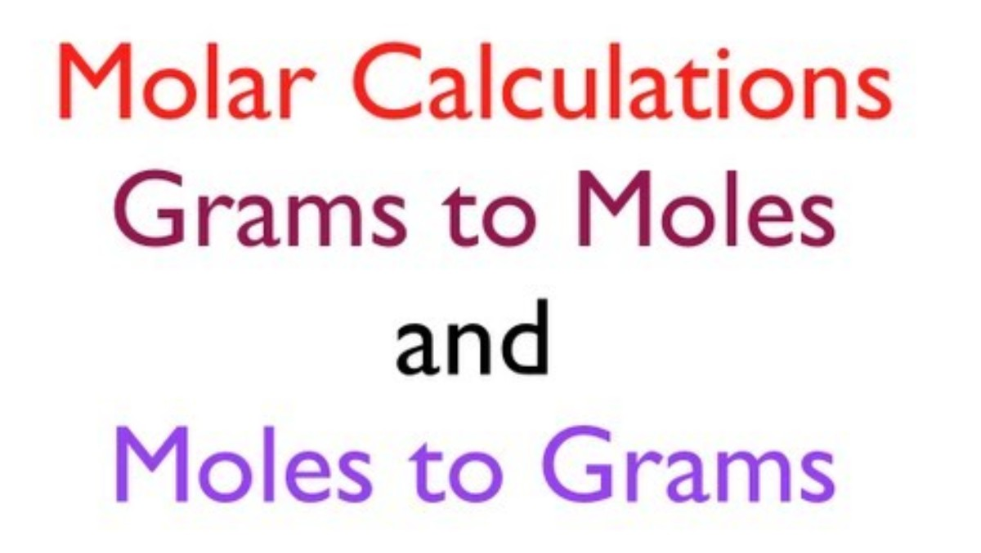
Five & half minute Watch

Slide 18
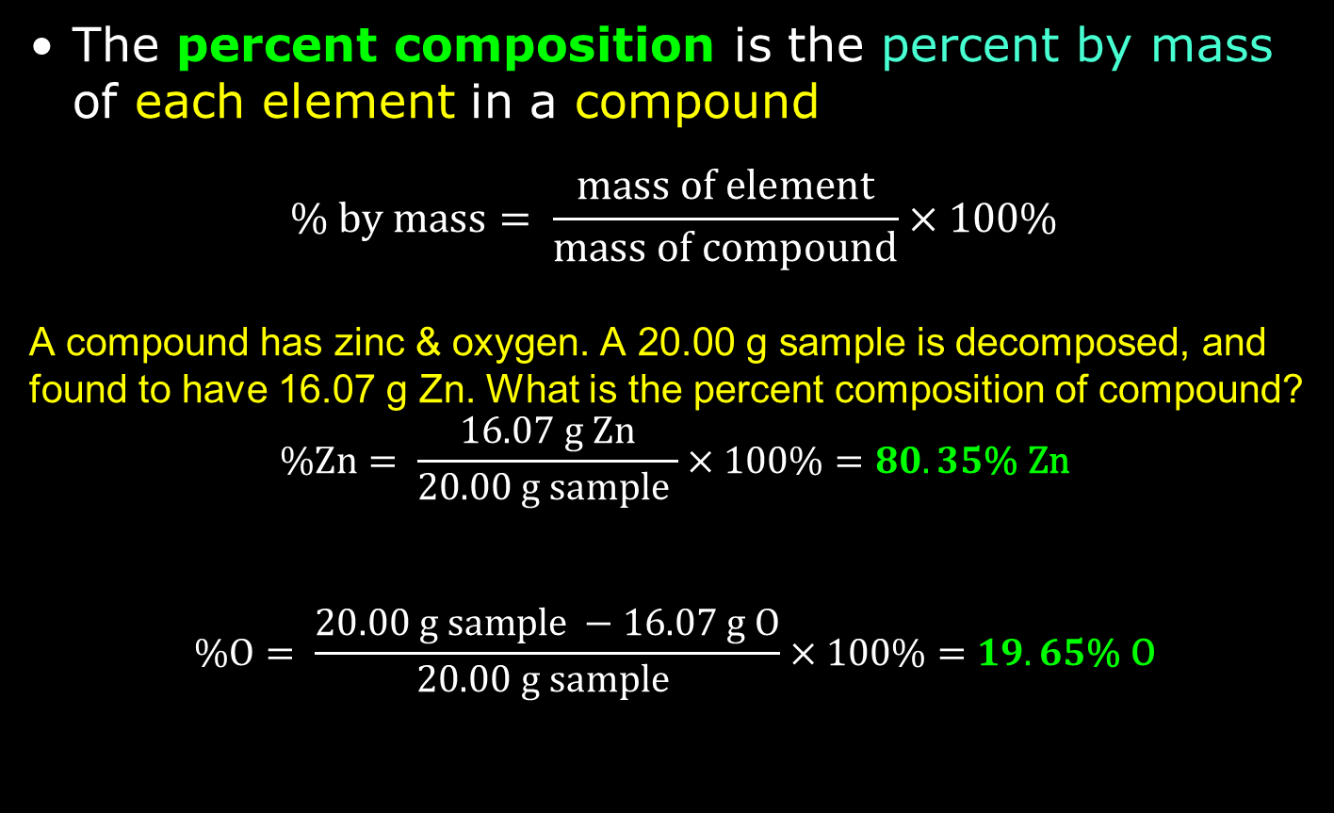
Percent Composition
The percent composition is the percent by mass of each element in a compound
$$\% by mass= \frac{mass of element}{mass of compound}×100\%$$
A compound has zinc & oxygen. A 20.00 g sample is decomposed, and found to have 16.07 g Zn. What is the percent composition of compound?
$$\text{\%Zn}= \frac{\text{16.07 g Zn}}{\text{20.00 g sample }}×100\%=80.35\text{\% Zn}$$
$$\text{\%}\text{O}= \frac{20.00 g sample −\text{16.07 g }\text{O}}{\text{20.00 g sample }}×100\%=19.65\text{\% }\text{O}$$

Slide 19
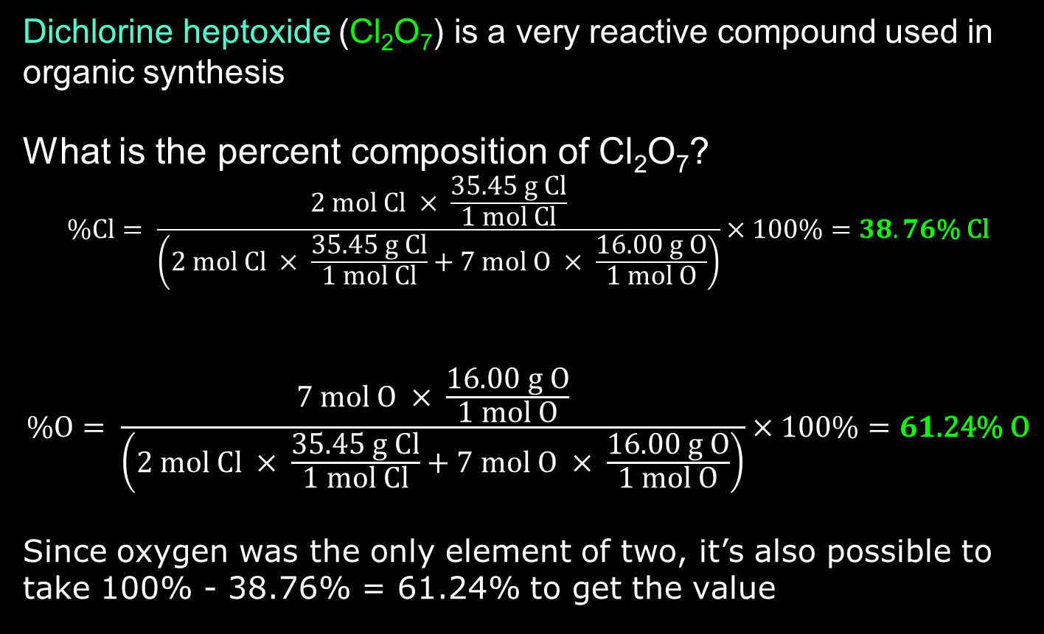
% Composition from Formula
Dichlorine heptoxide (Cl₂O₇) is a very reactive compound used in organic synthesis
What is the percent composition of Cl₂O₇?
$$\text{\%Cl}= \frac{\text{2 mol }\text{C}l × \frac{35.45 g Cl}{1 mol Cl}}{\left(\text{2 mol C}l × \frac{35.45 g Cl}{1 mol Cl}+\text{7}\text{ mol }O × \frac{16.00 g O}{1 mol O}\right)}×100\%=38.76\text{\% Cl}$$
$$\text{\%}\text{O}= \frac{\text{7}\text{ mol }O × \frac{16.00 g O}{1 mol O}}{\left(\text{2 mol C}l × \frac{35.45 g Cl}{1 mol Cl}+\text{7 mol }O × \frac{16.00 g O}{1 mol O}\right)}×100\%=61\text{.24}\text{\% }\text{O}$$
Since oxygen was the only element of two, it’s also possible to take 100% - 38.76% = 61.24% to get the value

Slide 20
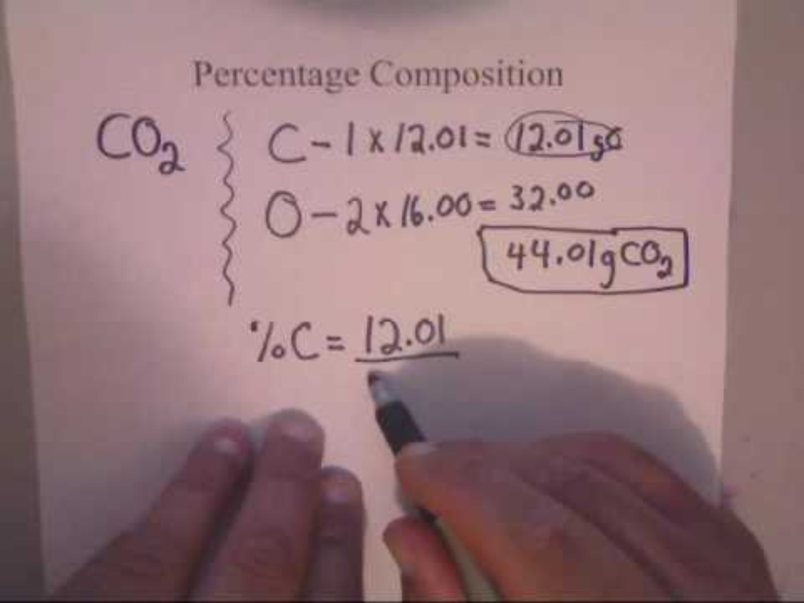
% Composition Video

Slide 21

A Formula for Mass of Elements
To get the mass in grams of each element, suppose there are x of the compound Cl₂O₇ in a sample.
To calculate the grams of element Cl and of element O in Cl₂O₇, just use the formulas:
$$mass of sample \left(g\right)×38.76\text{\% Cl = mass of Cl (g)}$$
$$mass of sample \left(g\right)×61.2\text{4}\text{\% }\text{O}\text{ = mass of }\text{O}\text{ (g)}$$
Example: a 12.50 g Cl₂O₇ sample has 4.845 g Cl and 7.655 g O

Slide 22
Empirical Formula Determination
Recall that the definition of empirical formula is the lowest integer ratio of the elements in a compound. For instance, glucose has a molecular formula of C₆H₁₂O₆, but its empirical formula is CH₂O
The reason for the empirical formula was because in analyzing a substance, it was the proportions of the elements chemists first saw in the analysis. They did not immediately have an understanding of how many atoms of each element actually made up a molecule or formula unit
The process of getting the empirical formula is called elemental analysis

Slide 23
Elemental Analysis
Get exactly 100 g of the compound: enables the grams of a component element to also be the percentage of the component element
Determine from the mass in grams of a component element to moles of it using molar mass
Find the component element with the fewest (smallest number) moles of the compound, and use that number to divide the mole values of all other elements; the element with fewest moles should be 1
Step 3 should hopefully produce (almost) integer values in all other elements: those integers become the subscripts of the elements in the formula
In some cases, step 3 may be produce integer values: multiply each of moles by smallest whole number to convert each into whole number. Write formula

Slide 24
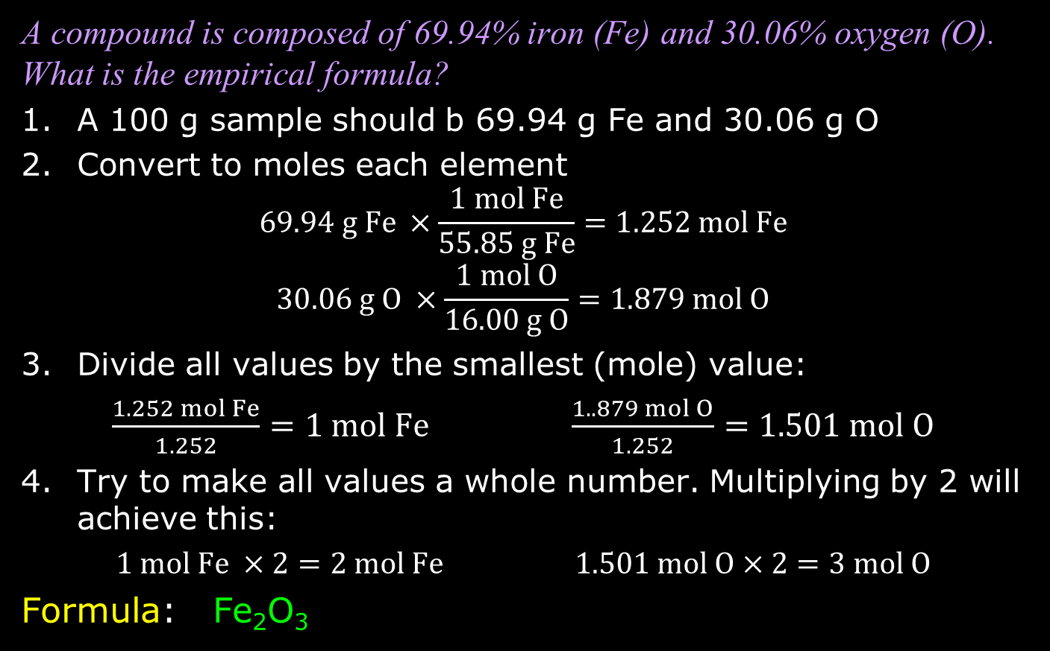
Elemental Analysis: Example
A compound is composed of 69.94% iron (Fe) and 30.06% oxygen (O). What is the empirical formula?
A 100 g sample should b 69.94 g Fe and 30.06 g O
Convert to moles each element
$$69.94 g Fe ×\frac{1 mol Fe}{55.85 g Fe}=1.252 mol Fe$$
$$30.06 g O ×\frac{1 mol O}{16.00 g O}=1.879 mol O$$
Divide all values by the smallest (mole) value:
$\frac{1.252 mol Fe}{1.252}=1 mol Fe$ $\frac{1..879 mol O}{1.252}=1.501 mol O$
Try to make all values a whole number. Multiplying by 2 will achieve this:
$1 mol Fe ×2=2 mol Fe$ $1.501 mol O×2=3 mol O$
Formula: Fe₂O₃

Slide 25
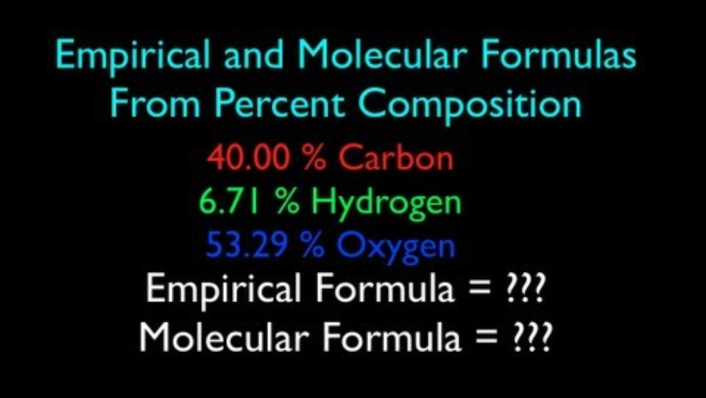

Slide 26
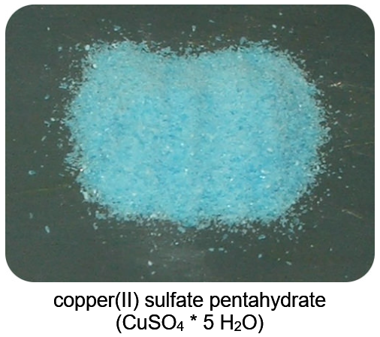
Bluish-Green vs White Copper Sulfate
Copper(II) sulfate is a typical
ionic compound which is white
in color as a solid
But when hydrated, H₂O
molecules coordinate around
the copper atom through the
orbitals of its d electrons, and
this coordinate bonding creates
a bluish-green color for the compound
Water molecules actually coordinate with formula units of many ionic compounds. Metal atoms in anhydrous form are often colored, but this bonding to H₂O molecules can cause a different color

Slide 27
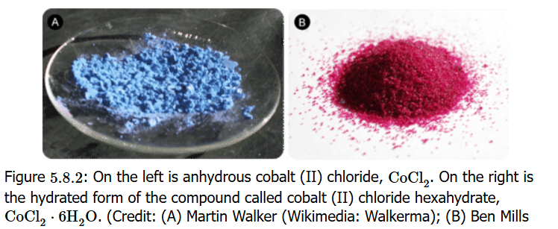
Other Hydrates: Cobalt(II) Chloride
Useful to know the percent water in a hydrate
What is the % hydrate of cobalt(II) chloride hexahydrate (CoCl₂ • 6 H₂O)?

Slide 28
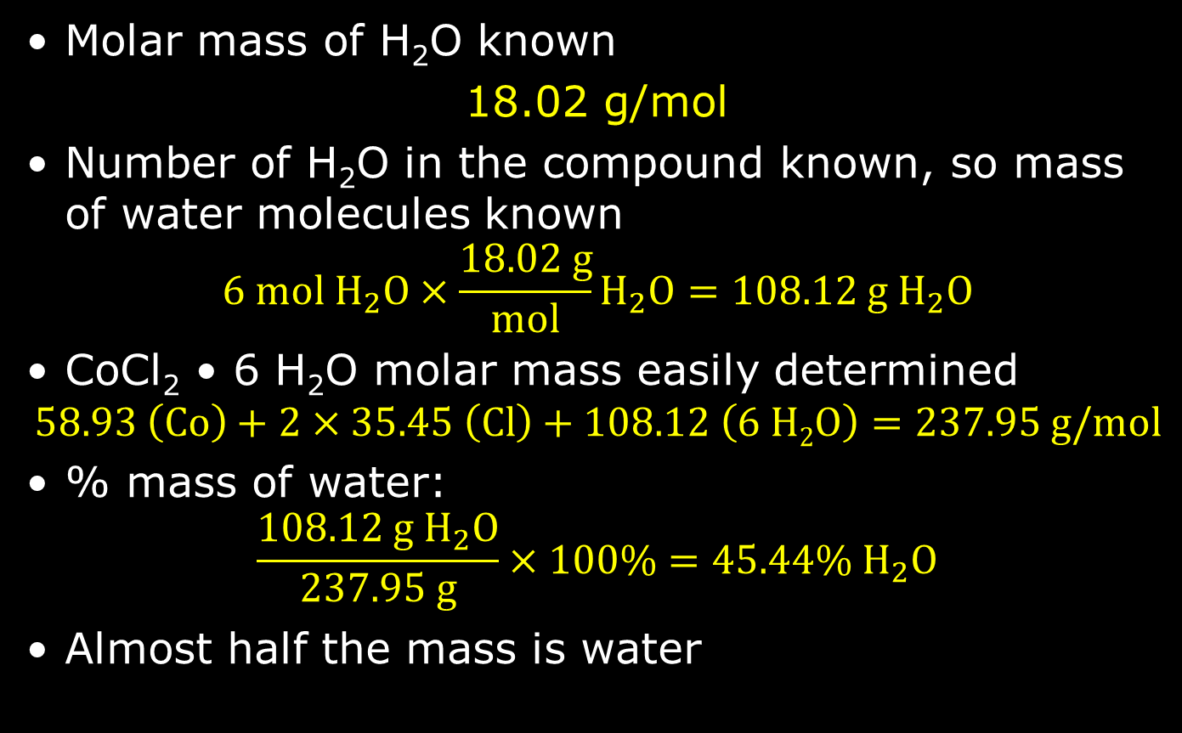
Percent Water in CoCl₂ • 6 H₂O
Molar mass of H₂O known
18.02 g/mol
Number of H₂O in the compound known, so mass of water molecules known
$$6 mol{ H}_{2}O×\frac{18.02 g}{mol}H_{2}O=108.12 g H_{2}O$$
CoCl₂ • 6 H₂O molar mass easily determined
$$58.93 \left(Co\right)+2×35.45 \left(Cl\right)+108.12 \left(6 H2O\right)=237.95 g/mol$$
% mass of water:
$$\frac{108.12 g{ H}_{2}O}{237.95 g}×100\%=45.44\% H_{2}O$$
Almost half the mass is water

Slide 29
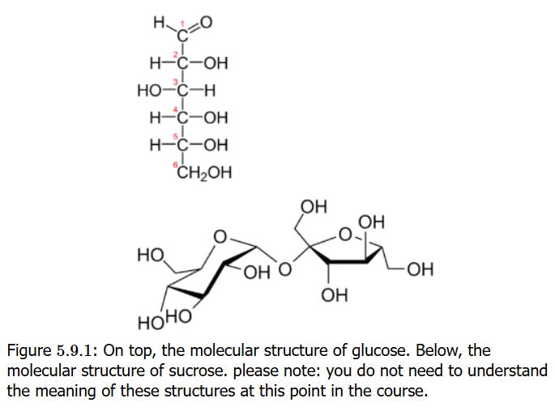
Glucose and Sucrose
Glucose is a monosaccharide (carbohydrate) essential to life, metabolized (“burned”) using oxygen (O₂) to carbon dioxide (CO₂) and water (H₂O)
Sucrose (table sugar) is a disaccharide of glucose and fructose,
and fructose is an
isomer of glucose easily
converted to glucose in
metabolism
How does one
distinguish between
glucose and sucrose?

Slide 30
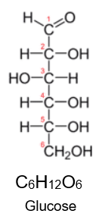
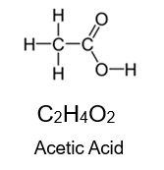
Molecular Formula Determination
Molecular formulas: the info about the kind and the number of atoms of each element present in a molecular compound
The molecular formula and empirical formula can be identical in many cases, e.g. in methane (CH₄)
Acetic acid (main acid in vinegar) and
glucose have different molecular formulas
but the same empirical formula:
CH₂O
Empirical formulas are learned from
percent composition elemental
analysis
Molecular formulas require knowing
molar mass of compound

Slide 31
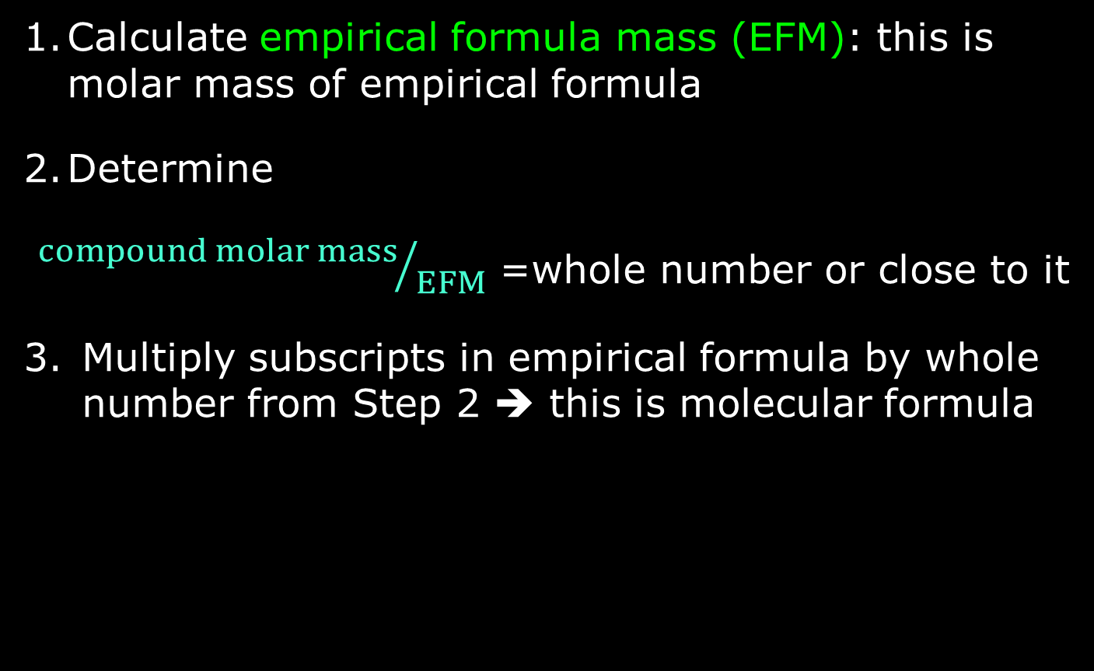
Empirical ➔ Molecular Formula
Calculate empirical formula mass (EFM): this is molar mass of empirical formula
Determine
${compound molar mass}/{EFM}$ =whole number or close to it
Multiply subscripts in empirical formula by whole number from Step 2 ➔ this is molecular formula

Slide 32

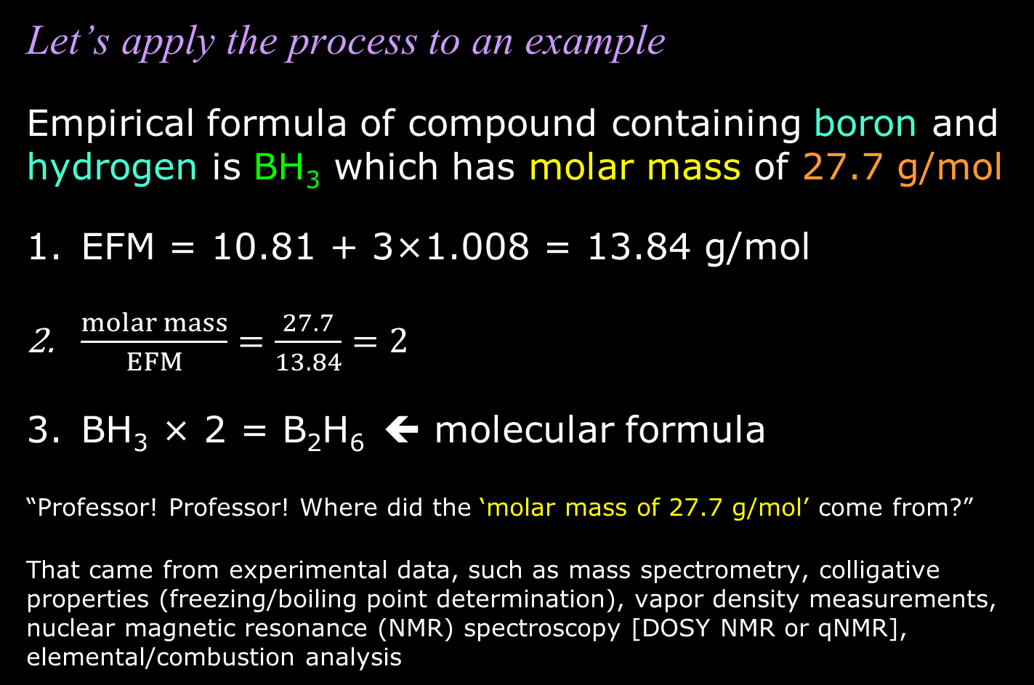
Empirical ➔ Molecular Formula
Let’s apply the process to an example
Empirical formula of compound containing boron and hydrogen is BH₃ which has molar mass of 27.7 g/mol
EFM = 10.81 + 3×1.008 = 13.84 g/mol
$\frac{molar mass}{EFM}=\frac{27.7}{13.84}=2$
BH₃ × 2 = B₂H₆ ⬅ molecular formula
“Professor! Professor! Where did the ‘molar mass of 27.7 g/mol’ come from?”
That came from experimental data, such as mass spectrometry, colligative properties (freezing/boiling point determination), vapor density measurements, nuclear magnetic resonance (NMR) spectroscopy [DOSY NMR or qNMR], elemental/combustion analysis

Slide 33
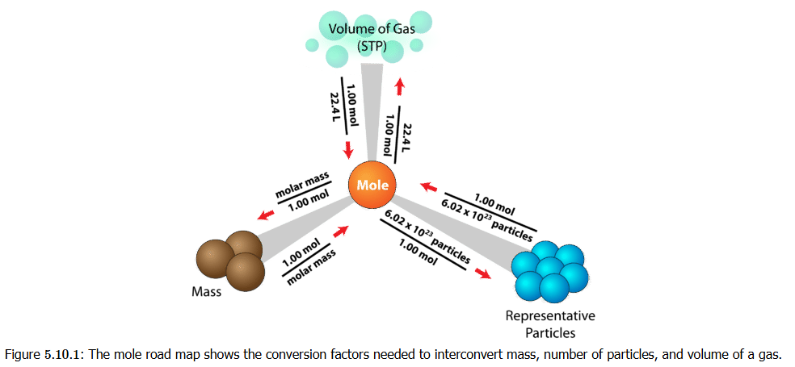
Converting Mass/Moles/Gas Volume
The online book’s Mole Road Map
Interrelates particle count, mass (in grams), and volume of a gas
Latter won’t be important until we get to gases

